Slide 1

6T- SRAM CELL DESIGN Sandeep Kumar (2K20/EC/186)

Slide 2
CONTENTS
INTRODUCTION
CIRCUIT DISCRIPTION
WORKING
TRANSIENT/OUTPUT WAVEFORM
STABILITY ANALYSIS
DELAY ANALYSIS
POWER ANALYSIS

Slide 3
INTRODUCTION
The first MOSFET based dynamic random access memory (DRAM) chip with 2k-bits was developed in 1971 with several process improvements in leakage control. However, DRAM performance has not kept the pace with the performance of the processors from the very beginning[29,42] due to long access time and more power hungry. The dynamic nature of DRAM requires that the memory must be refreshed periodically so as not to lose the content of the memory cells. The growing gap between the processors and the DRAM performance has dictated the need of different levels of memory hierarchy in the processor architectures. The memory hierarchy ranges from high-performance, small sized but expensive on-chip memories to slower, large sized but inexpensive off-chip memories such as DRAM, magnetic or optical memories. To meet the system performance requirements, the processor tries to keep frequently used data and instructions closer to itself, that is, in the faster on-chip memory, which is referred as “cache” memory. The different levels of cache memories are static random access memories(SRAMs) and they dominate the memory hierarchy in performance but they areoften integrated in a lesser capacity due to area limitations and the high cost per bit. The speed and the cost per bit decrease as one moves from registers to tertiarystorage, however, data storage capacity increases. SRAMs continue to be critical component across a wide range of microelectronics applications from consumer wireless to high performance server processors,multimedia and System on Chip (SoC) applications.

Slide 4
CIRCUIT DESCRIPTION
Standard 6T SRAM bitcell topology has been widely used inthe implementation of cache memory in high performance microprocessors and on chip caches in SoC products. Recently, several SRAM bitcell topologies that have been proposed to achieve different objectives such as minimum bitcell area, low static and dynamic power dissipation, improved performance and better parametricyield in terms of SNM and WAM. However, other techniques such as boosting the supply voltage, read and write assist circuitries in SRAMs have also been proposed to achieve more stable data retention during read operations [53, 66]. The prime concern in SRAM bitcell design is a trade-off among these design metrics. For example, in sub-threshold SRAMs, noise margin (robustness) is the key design parameter and not speed [111,112]. Therefore, on the basis of their robustness these bitcell topologies are broadly divided into two categories: (1) non-isolated read port SRAM bitcell topologies (less robust), and (2) isolated read-port SRAM bitcell topologies (highly robust).

Slide 5
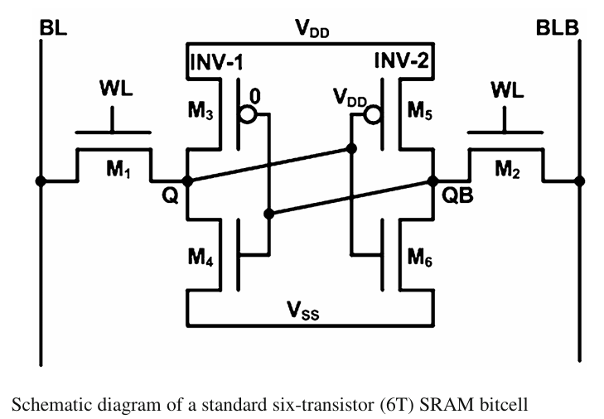

Slide 6
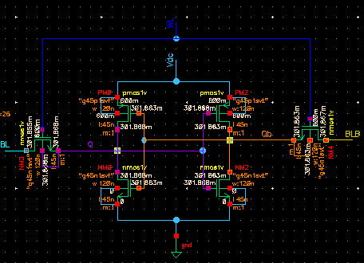
6T SRAM schematic in cadance

Slide 7
Precharge circuit
In all SRAMs, for each column in the bitcell array there is a bitline pair (BL andcomplement of BL). Each pair of bitlines is connected to a precharge circuit. Thefunction of this circuit is to pull-up the bit lines of a selected coulmn to VDD leveland perfectly equalized them before the read or write operation.
It is composed of a pair of PMOS transistors and a precharge circuit enable signal (PC), when both the transistors are in ON state,
that is, PC is active low, bitlines (BL and complement of BL) are connected to VDD.
In this precharge circuit transistor M1 and M2 connect the bitlines (BL and complement of BL) to VDD for
pull-up, while transistor M3 equalizes both the bitlines.

Slide 8
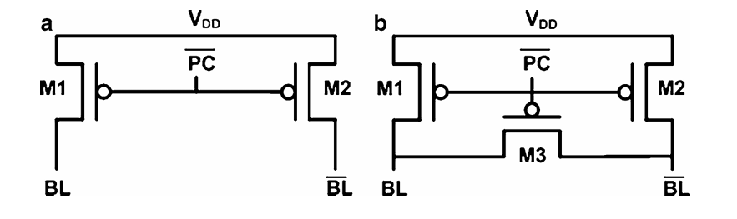
Precharge circuits for SRAM array

Slide 9
Sense Amplifiers
The primary function of a SA in SRAMs is to amplify a small differential voltage developed on the bitlines during read access and translate it to full swing digital output signal. A small differential voltage is developed by pulling down one of the precharged bitline by the read access bitcell. Due to small bitcell size and large bitlines capacitance, time required for read operation increases significantly, or in other words, read access time increases. a commonly used current-mirror differential sense amplifier.
The differential sensing is widely used to reject the common-mode noise that may present on both the bitlines. This noise may be induced on both SA inputs or bitline pair (BL and complement of BL) due to power spikes, capacitive coupling between
Sense amplifier begins with setting up the SA operating point by precharging and equalizing of the both the SA inputs, that is, the bitline pair (BL and complement of BL) of a selected column. Once both bitlines are precharged and equalized, wordline WL is asserted to activate the read accessed bitcells that started build-up of the differentialvoltage on the bitlines. Once the differential voltage exceeds the sensitivity of the SA or overcomes the offset of SA,Sense AmplifierEnable(SAE)signalis issued to triggerthe SA whichamplifies the differential voltage caused by the bitcell on the bitlines to full-swing digital output level. The read operation completes with the de-assertion of the SAE and WL.

Slide 10
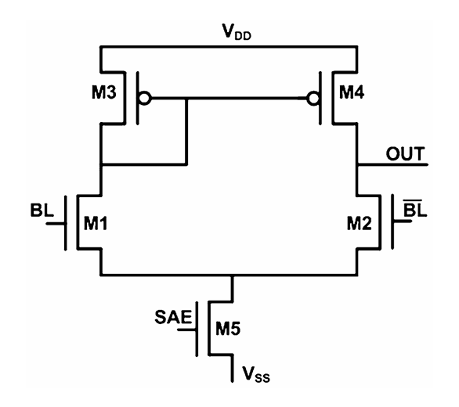

Figure: Commonly used current-mirror differential sense amplifier

Slide 11
Write Drivers
Write drivers are used by a group of columns in an SRAM array to control the bitline pair (BL and complement of BL) during write operation. As the bitline pair is precharged to VDD before every operation, the write driver has just to act the pull down one of the two bitlines below the write margin of the SRAM cell during write operation according to the input data.
write driver shown in Fig.1.12 writes data through two stacked NMOS transistors, that is, M1, M3 and M2, M4, which formtwo pass-transistor AND gates. Write driver is enabled by the WE signal which activates the transistor M3 and M4, while data in enablesthe transistor M1 or M2 dependinguponthe inputdatathrough inverter buffers (INV-1 and INV2). When WE is enabled, one of the bitline (BL and
complement of BL) is discharged from precharged level to ground through one of the transistor M1 or M2 depending upon the input data.

Slide 12
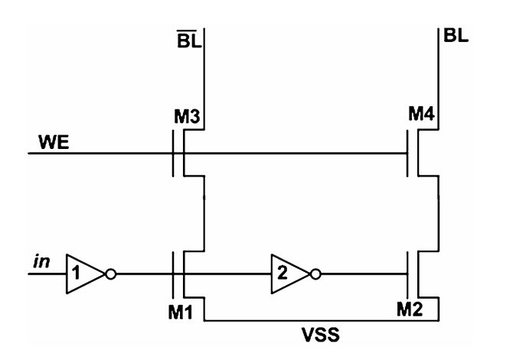
Figure: Pass gates based write driver circuit

Slide 13
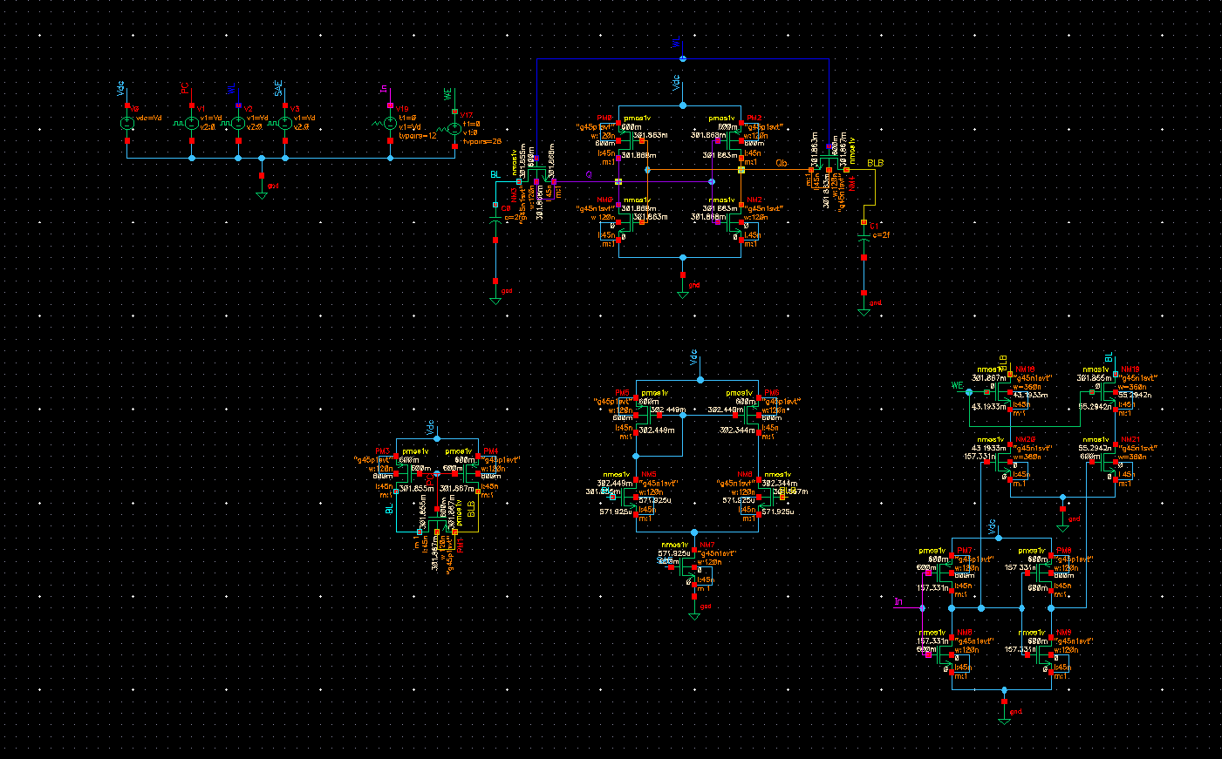
6T SRAM Circuit

Slide 14
Read Operation
Without loss of generality, it is assumed that the internal data storage nodes Q and Q Bareat ‘0’and‘1’, respectively.
• Conventionally to read a bitcell, the bitlines (BL and BLB) are precharged to the supply voltage (VDD). In some SRAM designs these bitlines are precharged to intermediate level of 0 and VDD.
• Thewordline (WL) is asserted to high.
• Rise the WL from ‘0’ to ‘1’, result, one of the bitcell sides (node) stores the logical ‘0’; that side of the bitline is discharged through the pass-gate and pull down transistors. In standard 6T, devices M1 and M4 discharges the precharged bitlines BL.
If BLB goes to low (or discharges), then the bitcell holds a logic ‘1’ value, which correspond.Standard 6T SRAM Bitcell: An Overview 33- If BL goes to low (or discharges), then the bitcell holds a logic ‘0’ value, which correspond.
• Depending upon whether the bitline BL or BLB is discharged, the bitcell is read as a logical ‘1’ or ‘0’. A sense amplifier converts the differential signal exists on BLand BLBtoalogic-level output.
• De-assert the wordline (WL) back to 0. During a read operation, the internal node (say Q) of the bitcell that holds a logical ‘0’ will pull its bitline (BL) low throughthe pass-gate transistor, M1 and pull down transistor, M4. It is important that the low internal node (Q) should not rise above the trip-point (switching threshold voltage) of the inverter INV-2,to avoid a destructive read operation. A destructive read operation can be prevented by ensuring a large enough bitcell ratio (β), in other words, pull-down
transistors (M4 and M6) must be stronger than the access transistors (M1 and M2).For a symmetric bitcell, bitcell ratio (β)isdefinedas:

Slide 15

In general, the bitcell ratio can be varied from 1.25 to 2.5 depending on the target application and desired static noise margin (SNM). A larger bitcell ratio makes the bitcell robust and provides higher SNM and read current Iread (and hence– the speed), at the expense of increased silicon overhead and leakage current. A smaller bitcell ratio, whilst maintaining an adequate speed and noise margin, makes the bitcell compact for a high density cache design but more vulnerable to process variation induced failures.

Slide 16
WRITE OPERATION
The write operation or flipping the bitcell contents when initially assuming that the internal data storage nodes Q and QB are at ‘0’ and ‘1’, respectively.
• Initially, wordline (WL) = 0.
• Precharge the bitlines (BL and BLB) to the supply voltage (VDD).
• After prechrage, both the bitlines (BL and BLB) are disconnected from the supply voltage (VDD).
• Wordline (WL) is activated to high (data enters the bitcell during this step).
• Place the data value on the BL and the complementary data value on BLB.
• Thebitline BLB connected to the data storage node QB via M2, isdriventothe ground potential by a write driver through the M2 pass-gate transistor, while the BL is remained held at VDD to pull node Q to high via M1 pass-gate transistor.
• AsnodeQandQBfliptheir states de-assert the wordline (WL) back to 0. As a result, node QB pulled well below the trip-point of the INV-1, so that, the feedback loop in the cross-coupled inverter starts to work and the bitcell is flipped. It is important that a successful write operation primarily dependsupontheproperlysized pass-gate transistors and pull-up transistors. Hence, the pull-up ratio (PR) for a symmetric SRAM bitcell is defined as

Slide 17

During write operation fight occurs between pass-gate transistors (M1 and M2) and pull-up transistors (M3 and M5) mainly when the value of the data to be written into the bitcell is the opposite of the value that is currently stored in the bitcell. For instance, assumed that the bitcell currently holds a logic ‘1’ and it is intended to write a logic ‘0’ into the bitcell. Then, the situation correspondthe following biasing conditions; BLB, WL and bitcell supply voltage is biased at VDD and BL is biased at VSS in Fig.2.2a. For a successful write operation, node QB must be pulled above the trip point of the inverter “INV1” and node Q must be pulled down below the trip-point of the inverter “INV2”. In this mode, fight occurs between M1 and M3. Since M1 will try to bringnode Q to downwhile M3 will tryto keep nodeQ to high.Therefore, M1 must win the fight for a successful write operation. Once an inverter switches, it creates a self-reinforcing positive feedback action that continue until the bitcell has been fully placed into a new stable state. A successful write operation can be guaranteed by choosing a lower PR value (generally, PR = 1), that can be achieved by employing the wider or stronger pass
gate transistors (M1 and M2) instead of pull-up transistors (M3 and M5). However, increasing the width of the pass-gate transistors threatens the stability of the bitcell during the read cycle, or in other words reduces the read SNM of the bitcell.

Slide 18
Hold Operation: This is the state when the SRAM cell is idle (data is held in latch) and the bit line and bit line bar (data path) are kept at gnd when the access transistors are disconnected because the word line is not inserted.

Slide 19
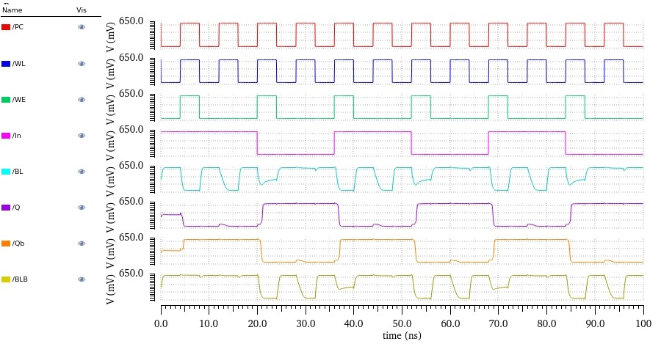
Transient waveform of 6T SRAM Cell

Slide 20
Parameters | 6T
1. Supply Voltage | 0.6
2. Read delay(ps) | 221
3. Write delay (ps) | 1232
4. RSNM (mv) | 115.2
5. HSNM (mv) | 184.4
6. WSNM (mv) | 126
7. Leakage power (nw) | 9.6
8. Dynamic Power (nw) | 9.43
Table- 6T SRAM cell result in 90-nm CMOS Technology

Slide 21
Read SNM measurement
Sure, the SNM (Static Noise Margin) measurement in a 6T SRAM (Static Random-Access Memory) cell is a critical assessment of the stability of the memory cell in retaining data under different voltage conditions.
The 6T SRAM cell consists of six transistors organized in a way that allows for data storage. The two inverters within the cell form a latch, maintaining the stored data until it is actively changed. SNM measurement helps determine the voltage difference between the '0' and '1' states, ensuring the reliability of data storage and retrieval.
To measure the SNM in a 6T SRAM cell, engineers typically perform voltage sweeps across different operating conditions. They gradually vary the voltage applied to the cell's nodes to find the voltage levels at which the cell transitions between '0' and '1' states reliably. This involves assessing the stability of the stored data by analyzing the margin between these voltage thresholds.
The SNM measurement is crucial in semiconductor design and manufacturing as it ensures that the memory cells can operate reliably under various conditions such as process variations, temperature changes, and voltage fluctuations. It helps in determining the robustness and reliability of the memory cell's ability to store and retain data in real-world operating environments.

Slide 22
Write SNM Measuremen
Designing the Static Noise Margin (SNM) measurement for a 6T SRAM (Static Random-Access Memory) cell involves several steps and considerations within the semiconductor design process. Here's an overview of the key aspects involved in designing the SNM measurement for a 6T SRAM cell:
1. Circuit Layout and Schematic Design:
6T SRAM Cell Structure: Create a layout and schematic design of the 6T SRAM cell, comprising six transistors organized in a latch structure. This structure forms the basic unit for data storage in the SRAM.
2. Simulation Setup:
Modeling and Simulation: Utilize specialized software tools to simulate the behavior of the 6T SRAM cell under varying voltage conditions. These simulations help in predicting the behavior of the cell and understanding its stability in storing '0' and '1' states.
Voltage Sweep Simulation: Set up simulations that involve sweeping voltage across different nodes of the SRAM cell to identify the voltage levels at which the cell reliably stores and retrieves data.
3. SNM Measurement Techniques:
Voltage Margin Analysis: Analyze the simulation results to determine the Static Noise Margin. This involves identifying the voltage difference between '0' and '1' states at which the cell maintains data integrity reliably.
Threshold Voltage Analysis: Assess the threshold voltages necessary for stable operation, ensuring the cell operates within specified voltage ranges.

Slide 23
4. Characterization and Optimization: Performance Characterization: Evaluate the performance of the SRAM cell under different conditions, such as process variations and temperature changes, to ensure robustness. Optimization: Fine-tune the SRAM cell design parameters to improve SNM, considering factors like transistor sizing, layout optimizations, and circuit modifications to enhance stability. 5. Verification and Validation: Design Rule Checking: Verify the design against established industry standards and design rules to ensure compliance and reliability. SPICE Simulations: Conduct SPICE simulations to verify the functionality and performance of the 6T SRAM cell design, validating its behavior under various operating conditions. 6. Documentation and Reporting: Documentation: Document the design process, simulation results, optimization steps, and verification/validation outcomes for future reference and reporting purposes. Designing the SNM measurement for a 6T SRAM cell involves a comprehensive understanding of semiconductor device behavior, circuit design principles, simulation techniques, and optimization strategies to ensure reliable and robust memory cell operation.

Slide 24
Read Delay
Read delay is defined as the time delay between 50% of word-line (WL) activation to 10% of pre-chargedvoltage difference between the bit-lines.

Slide 25
Write Delay
The write delay is defined as the time between the 50% activation of the word line (WL) to when the internal Q is flipped to 90% of its full swing.

Slide 26
Power Analysis
•Power consumption is of two types Dynamic power consumption and leakage power consumption of the cell.
Leakage power consumption: As SRAM cell spend the majority of their time in hold mode, the power consumed during this mode significantly contributes to the overall power dissipation. BL leakage and leakage in the inverters are the primary sources of power
consumption.
Dynamic power consumption: The majority of the total power consumption primarily consists of dynamic power, resulting from the charging and
discharging of BL capacitances during read and write operations.

